Slide 1
Technology and Twitter through Time
A.I. Attitudes
Peter Ilhardt
August 22, 2019
bgr.com

Slide 2
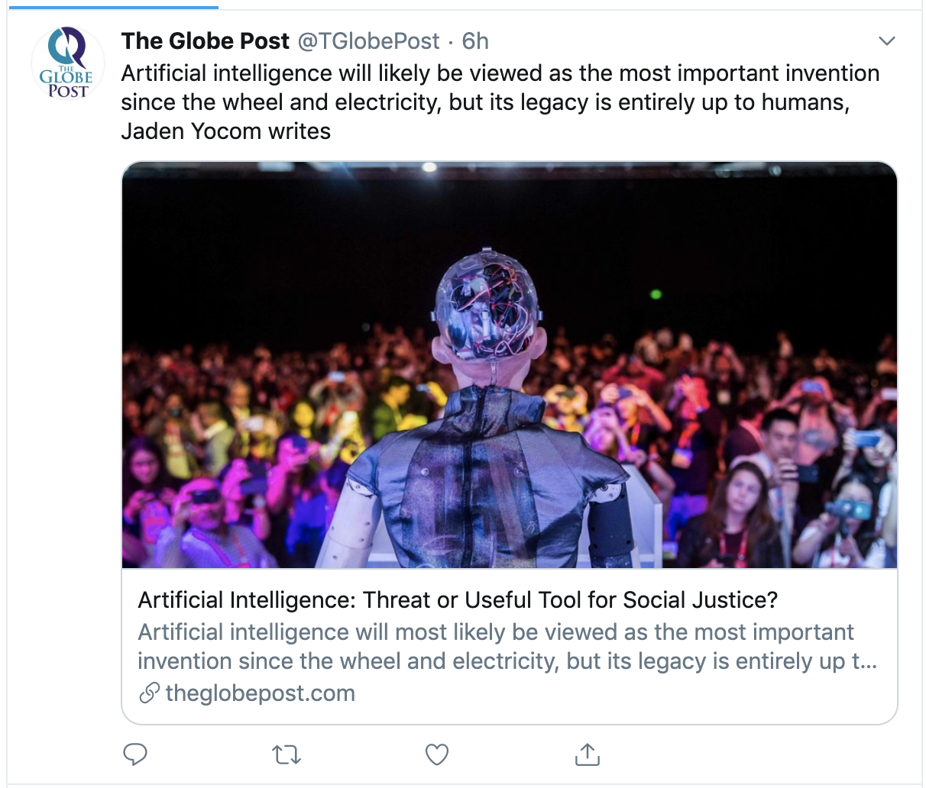
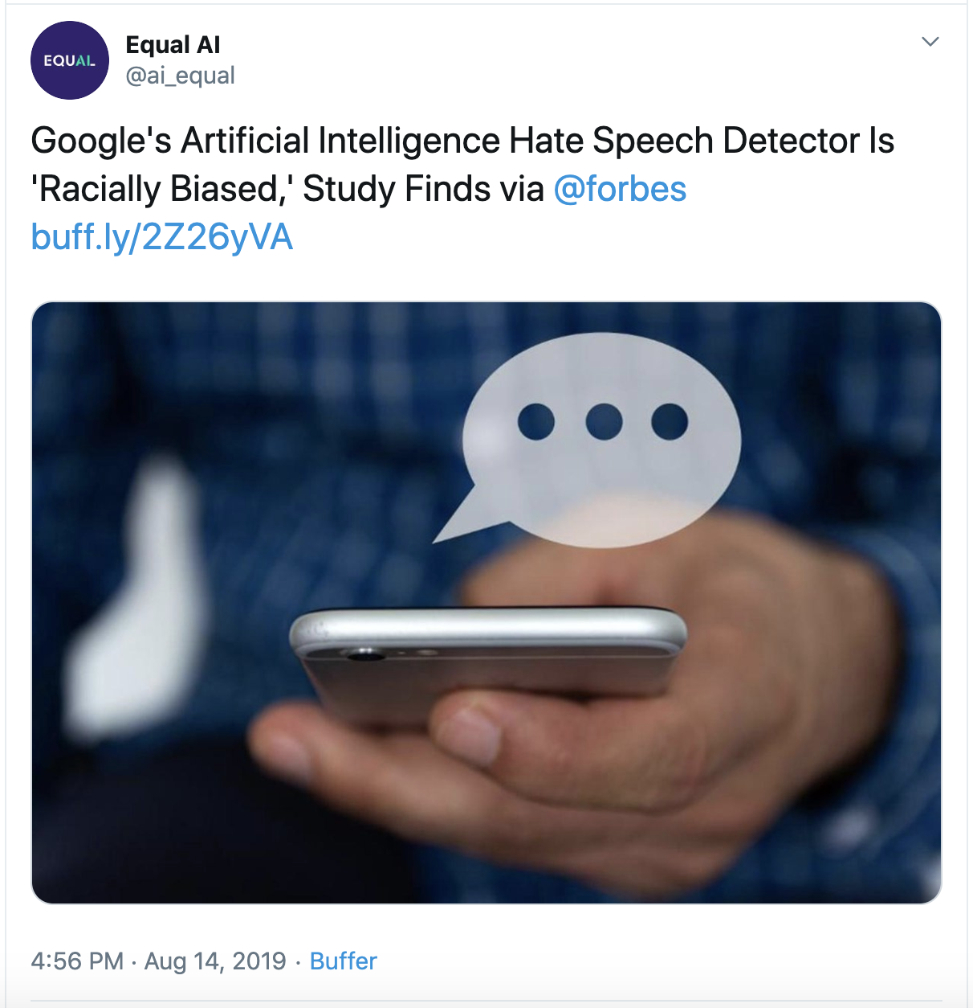

Slide 3
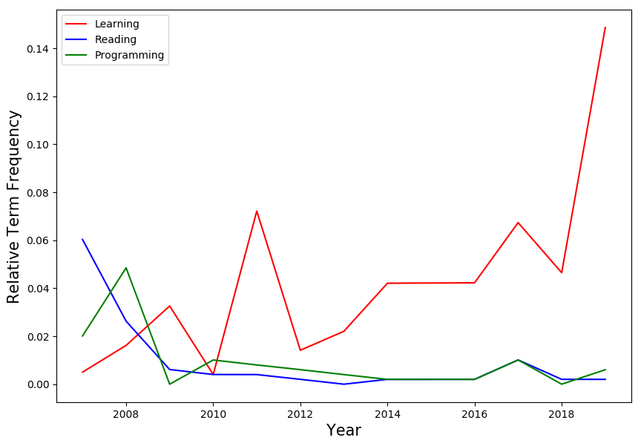
Have attitudes toward #AI changed over time? What do Twitter users associate with “A.I.”?

Slide 4
Probing the Twitterverse
Collected ~30,000 tweets since 2007 using ‘Artificial Intelligence’ keywords as well as ‘#AI’ and ‘#ArtificialIntelligence’
Applied natural language processing methods to extract topic themes
Conducted sentiment analysis over time using Google Cloud Natural Language API

Slide 5
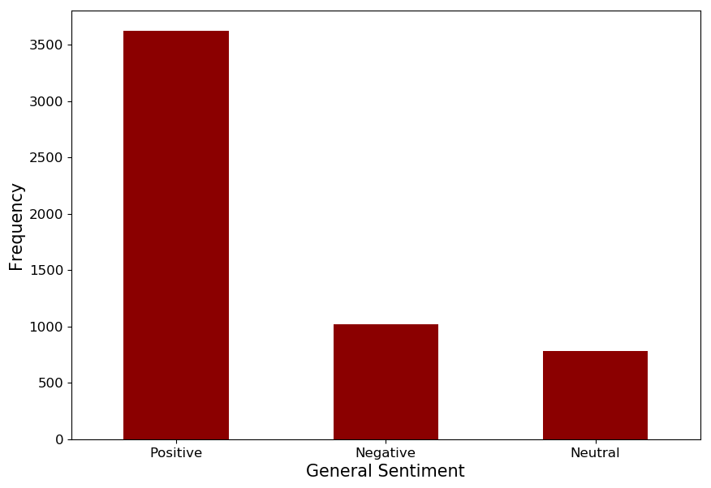
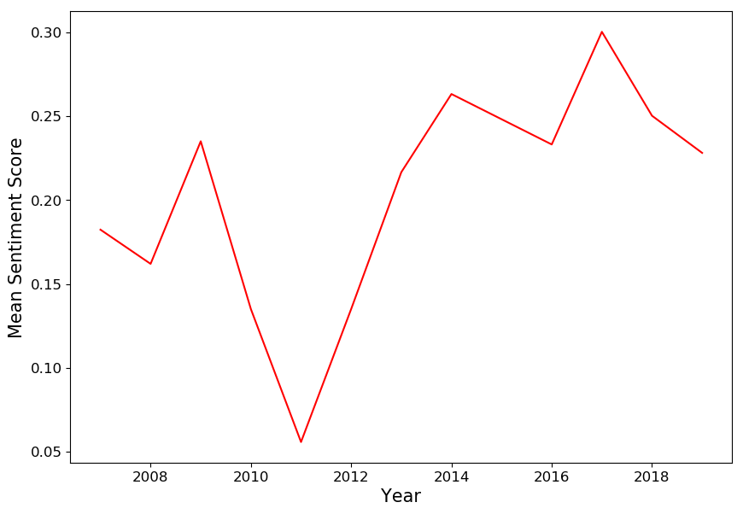
Generally Positive Sentiment toward A.I.

Slide 6
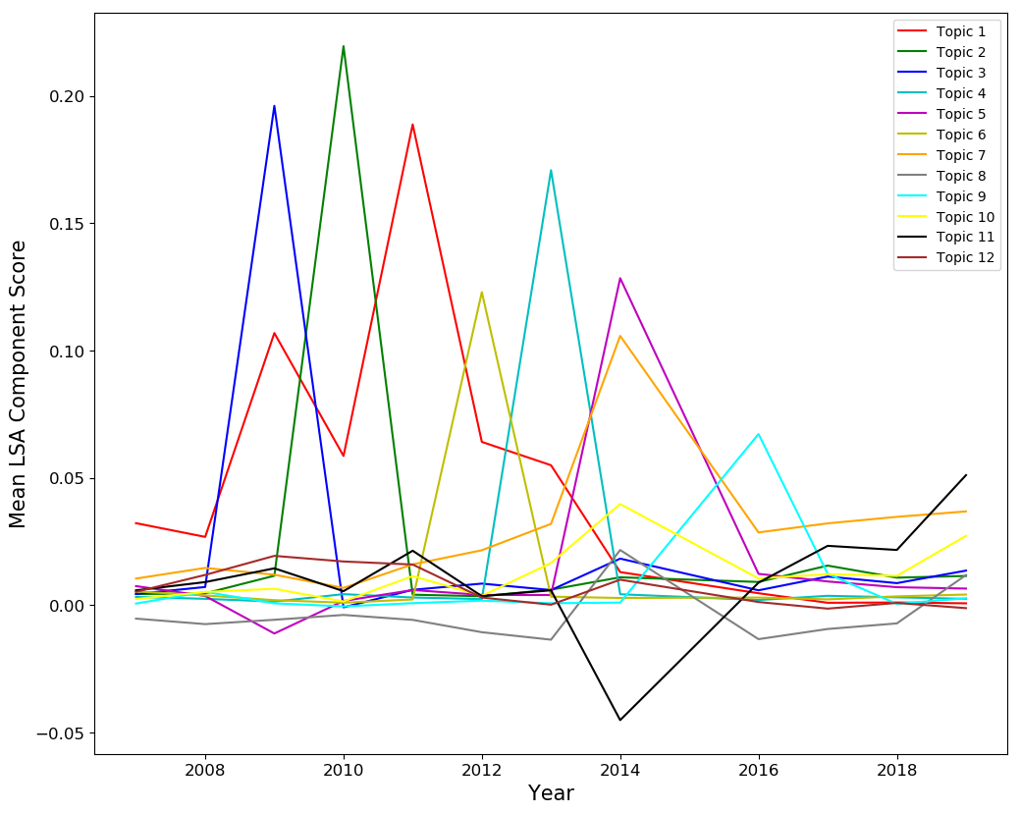
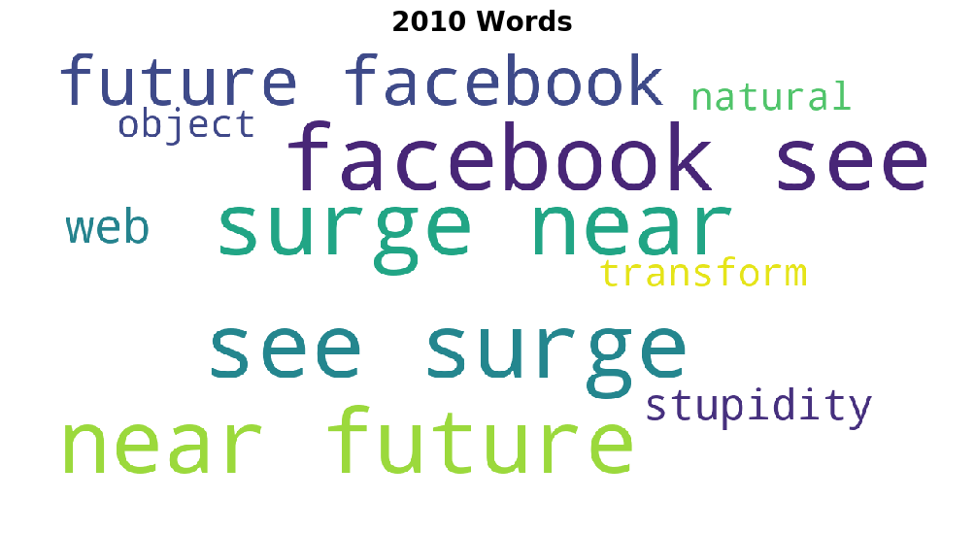
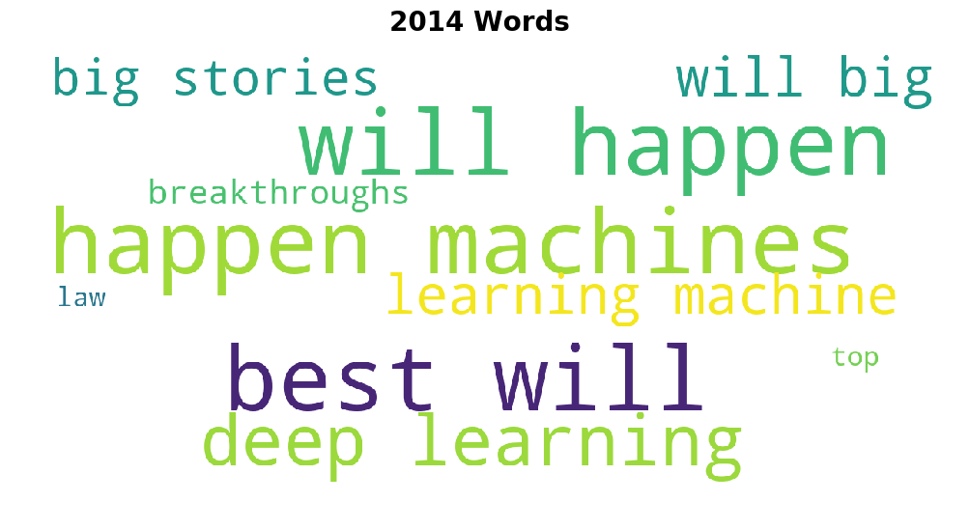
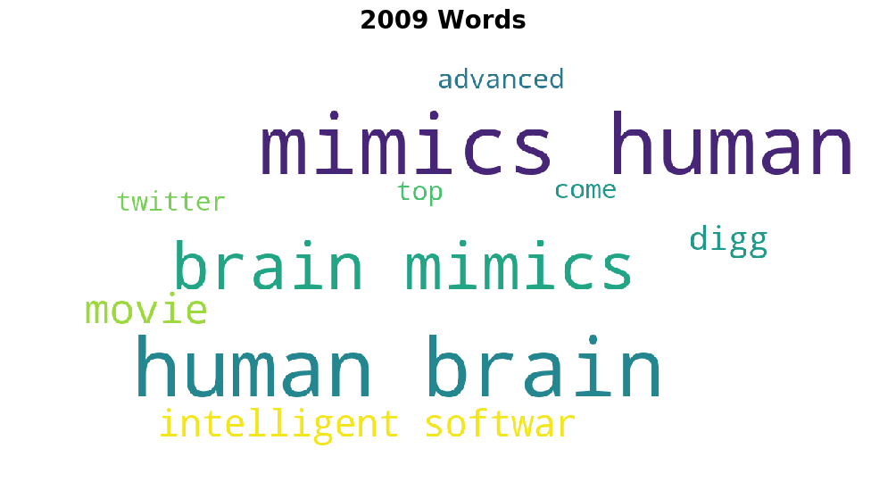
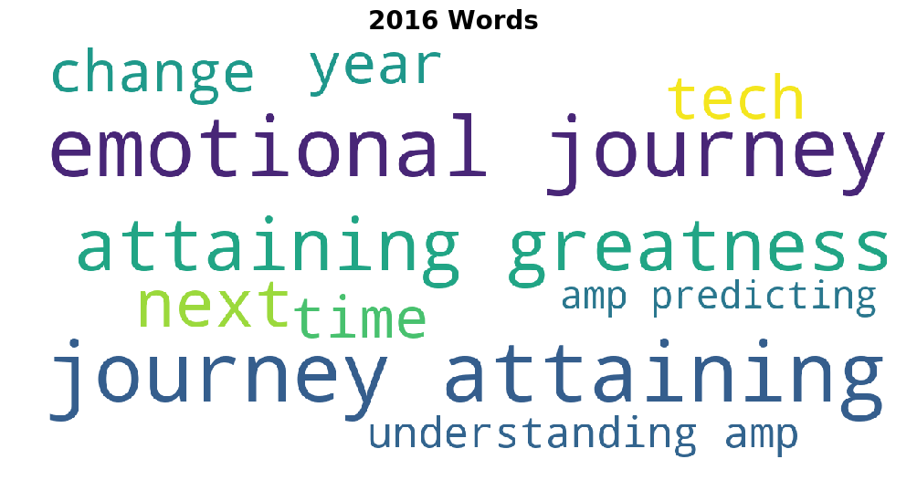

Slide 7
Key Insights
While sentiment towards modern technology has remained fairly consistently positive over the past 12 years, topics associated with ‘artificial intelligence’ evolve year-to-year
Public interest appears primarily driven by high-profile robotic achievements and movie releases
‘Deep learning’ and ‘machine learning’ have garnered significant interest and enthusiasm in the past five years that continue to grow

Slide 8
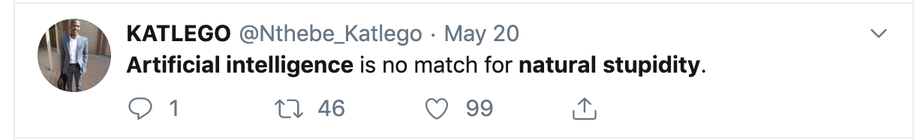

Slide 9
Appendix

Slide 10
